Slide 1
Introduction to classification k - Nearest Neighbour
Chapter 2

Slide 2
Nearest Neighbour
Mainly used when all attribute values are continuous
It can be modified to deal with categorical attributes
The idea is to estimate the classification of an unseen instance using the classification of the instance or instances that are closest to it, in some sense that we need to define (classifies new cases based on a similarity measure)

Slide 3

Nearest Neighbour
What should its classification be?
Even without knowing what the six attributes represent, it seems intuitively obvious that the unseen instance is nearer to the first instance than to the second.

Slide 4
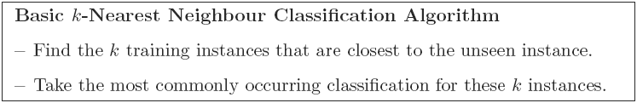
K - Nearest Neighbour (KNN)
In practice there are likely to be many more instances in the training set but the same principle applies.
It is usual to base the classification on those of the k nearest neighbours, not just the nearest one.
The method is then known as k-Nearest Neighbour or just k-NN classification

Slide 5
KNN
We can illustrate k-NN classification diagrammatically when the dimension (i.e. the number of attributes) is small.
Next we will see an example which illustrates the case where the dimension is just 2.
In real-world data mining applications it can of course be considerably larger.

Slide 6
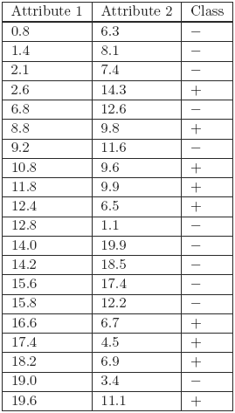
KNN
A training set with 20 instances, each giving the values of two attributes and an associated classification
How can we estimate the classification for an ‘unseen’ instance where the first and second attributes are 9.1 and 11.0, respectively?

Slide 7
KNN
For this small number of attributes we can represent the training set as 20 points on a two-dimensional graph with values of the first and second attributes measured along the horizontal and vertical axes, respectively.
Each point is labelled with a + or − symbol to indicate that the classification is positive or negative, respectively.

Slide 8
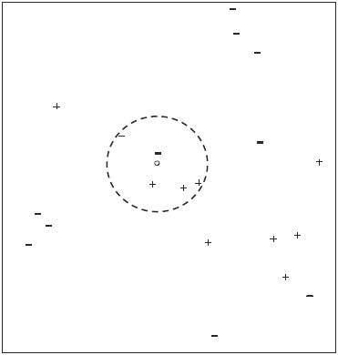
KNN
A circle has been added to enclose the five nearest neighbours of the unseen instance, which is shown as a small circle close to the centre of the larger one.

Slide 9
KNN
The five nearest neighbours are labelled with three + signs and two − signs
So a basic 5-NN classifier would classify the unseen instance as ‘positive’ by a form of majority voting.

Slide 10
KNN
We can represent two points in two dimensions (‘in two-dimensional space’ is the usual term) as (a1, a2) and (b1, b2)
When there are three attributes we can represent the points by (a1, a2, a3) and (b1, b2, b3)
When there are n attributes, we can represent the instances by the points (a1, a2, . . . , an) and (b1, b2, . . . , bn) in ‘n-dimensional space’

Slide 11
Distance Measures
There are many possible ways of measuring the distance between two instances with n attribute values, or equivalently between two points in n-dimensional space.
But here distance measurement usually imposes three requirements (let, dist(X, Y) denotes the distance between two points X and Y)
The distance of any point A from itself is zero, i.e. dist(A, A) = 0
The distance from A to B is the same as the distance from B to A, i.e.
dist(A, B) = dist(B, A) (the symmetry condition)
The third condition is called the triangle inequality (Figure 2.7). It corresponds to the intuitive idea that ‘the shortest distance between any two points is a straight line’. The condition says that for any points A, B and Z:
dist(A, B) ≤ dist(A, Z) + dist(Z, B)

Slide 12


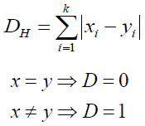
Distance Measures
There are many possible distance measures
Euclidean Distance
Manhattan Distance or City Block Distance
Hamming Distance …

Slide 13
Distance Measures: Euclidean Distance
If we denote an instance in the training set by (a1, a2) and the unseen instance by (b1, b2) the length of the straight line joining the points is
If there are two points (a1, a2, a3) and (b1, b2, b3) in a three-dimensional space the corresponding formula is
The formula for Euclidean distance between points (a1, a2, . . . , an) and (b1, b2, . . . , bn) in n-dimensional space is a generalisation of these two results. The Euclidean distance is given by the formula

Slide 14
Distance Measures: Manhattan Distance
The City Block distance between the points (4, 2) and (12, 9) is (12 − 4) + (9 − 2) = 8 + 7 = 15

Slide 15
KNN
A training set with 20 instances, each giving the values of two attributes and an associated classification
How can we estimate the classification for an ‘unseen’ instance where the first and second attributes are 9.1 and 11.0, respectively?
Use Euclidean Distance

Slide 16
Normalisation
A major problem when using the Euclidean distance formula (and many other distance measures) is that the large values frequently swamp the small ones.
When the distance of these instances from an unseen one is calculated, the mileage attribute will almost certainly contribute a value of several thousands squared, i.e. several millions, to the sum of squares total.

Slide 17
Normalisation
It is clear that in practice the only attribute that will matter when deciding which neighbours are the nearest using the Euclidean distance formula is the mileage.
We could have chosen an alternative measure of distance travelled such as millimetres or perhaps light years. Similarly we might have measured age in some other unit such as milliseconds or millennia. The units chosen should not affect the decision on which are the nearest neighbours.

Slide 18
Normalisation
To overcome this problem we generally normalise the values of continuous attributes.
The idea is to make the values of each attribute run from 0 to 1.
In general if the lowest value of attribute A is min and the highest value is max, we convert each value of A, say a, to (a − min)/(max − min).
Using this approach all continuous attributes are converted to small numbers from 0 to 1, so the effect of the choice of unit of measurement on the outcome is greatly reduced.

Slide 19
Normalisation
Note that it is possible that an unseen instance may have a value of A that is less than min or greater than max. If we want to keep the adjusted numbers 38 Principles of Data Mining in the range from 0 to 1 we can just convert any values of A that are less than min or greater than max to 0 or 1, respectively.

Slide 20
Normalisation
Another issue that occurs with measuring the distance between two points is the weighting of the contributions of the different attributes.
We may believe that the mileage of a car is more important than the number of doors it has.
To achieve this we can adjust the formula for Euclidean distance to
where w₁, w₂, . . . , w_{n} are the weights. It is customary to scale the weight values so that the sum of all the weights is one.

Slide 21
Dealing with Categorical Attributes
One of the weaknesses of the nearest neighbour approach to classification is that there is no entirely satisfactory way of dealing with categorical attributes.
One possibility is to say that the difference between any two identical values of the attribute is zero and that the difference between any two different values is 1. (Hamming Distance)
Effectively this amounts to saying (for a colour attribute) red − red = 0, red − blue = 1, blue − green = 1, etc.

Slide 22
Dealing with Categorical Attributes
Sometimes there is an ordering (or a partial ordering) of the values of an attribute (Ordinal Attribute), for example we might have values good, average and bad.
We could treat the difference between good and average or between average and bad as 0.5 and the difference between good and bad as 1.
This still does not seem completely right, but may be the best we can do in practice.

Slide 23
K-Nearest Neighbour
How Does the K-Nearest Neighbors Algorithm Work?
The K-NN algorithm compares a new data entry to the values in each data set (with different classes or categories).
Based on its closeness or similarities in a given range (K) of neighbors, the algorithm assigns the new data to a class or category in the data set (training data).
Let's break that down into steps:
Step #1 - Assign a value to K.
Step #2 - Calculate the distance between the new data entry and all other existing data entries . Arrange them in ascending order.
Step #3 - Find the K nearest neighbors to the new entry based on the calculated distances.
Step #4 - Assign the new data entry to the majority class in the nearest neighbors

Slide 24
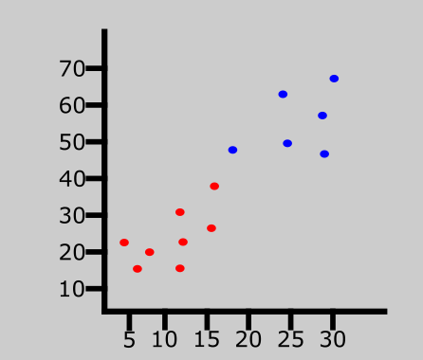
K-Nearest Neighbour
K-Nearest Neighbors Classifiers and Model Example With Diagrams

Slide 25
K-Nearest Neighbour
Brightness | Saturation | Class
40 | 20 | Red
50 | 50 | Blue
60 | 90 | Blue
10 | 25 | Red
70 | 70 | Blue
60 | 10 | Red
25 | 80 | Blue
The table represents our data set. We have two columns — Brightness and Saturation. Each row in the table has a class of either Red or Blue.
Brightness | Saturation | Class
20 | 35 | ?

Slide 26
K-Nearest Neighbour
Euclidean Distance
X₂ = New entry's brightness (20).
X₁= Existing entry's brightness.
Y₂ = New entry's saturation (35).
Y₁ = Existing entry's saturation.
For distance between two points:
√(X₂-X₁)²+(Y₂-Y₁)²

Slide 27
K-Nearest Neighbour
Distance #1
For the first row, d1:
d1 = √(20 - 40)² + (35 - 20)² = √400 + 225 = √625 = 25
Brightness | Saturation | Class
40 | 20 | Red
Brightness | Saturation | Class
20 | 35 | ?
Brightness | Saturation | Class | Distance
40 | 20 | Red | 25
50 | 50 | Blue | ?
60 | 90 | Blue | ?
10 | 25 | Red | ?
70 | 70 | Blue | ?
60 | 10 | Red | ?
25 | 80 | Blue | ?

Slide 28
K-Nearest Neighbour
Brightness | Saturation | Class
50 | 50 | Blue
Distance #1
For the first row, d1:
d1 = √(20 - 50)² + (35 - 50)² = √900 + 225 = √1125 = 33.54
Brightness | Saturation | Class
20 | 35 | ?
Brightness | Saturation | Class | Distance
40 | 20 | Red | 25
50 | 50 | Blue | 33.54
60 | 90 | Blue | ?
10 | 25 | Red | ?
70 | 70 | Blue | ?
60 | 10 | Red | ?
25 | 80 | Blue | ?

Slide 29
K-Nearest Neighbour
Brightness | Saturation | Class | Distance
40 | 20 | Red | 25
50 | 50 | Blue | 33.54
60 | 90 | Blue | 68.01
10 | 25 | Red | 14.14
70 | 70 | Blue | 61.03
60 | 10 | Red | 47.17
25 | 80 | Blue | 45.28

Slide 30
K-Nearest Neighbour
After Rearranging the table in ascending order:
Brightness | Saturation | Class | Distance
10 | 25 | Red | 14.14
40 | 20 | Red | 25
50 | 50 | Blue | 33.54
25 | 80 | Blue | 45
60 | 10 | Red | 47.17
70 | 70 | Blue | 61.03
60 | 90 | Blue | 68.01

Slide 31
K-Nearest Neighbour
Since we chose 5 as the value of K, we'll only consider the first five rows. That is:
Brightness | Saturation | Class | Distance
10 | 25 | Red | 14.14
40 | 20 | Red | 25
50 | 50 | Blue | 33.54
25 | 80 | Blue | 45
60 | 10 | Red | 47.17
As you can see above, the majority class within the 5 nearest neighbors to the new entry is Red. Therefore, we'll classify the new entry as Red.

Slide 32
K-Nearest Neighbour
Updated table
Brightness | Saturation | Class
40 | 20 | Red
50 | 50 | Blue
60 | 90 | Blue
10 | 25 | Red
70 | 70 | Blue
60 | 10 | Red
25 | 80 | Blue
20 | 35 | Red

Slide 33
K-Nearest Neighbour
How to Choose the Value of K in the K-NN Algorithm
There is no particular way of choosing the value K, but here are some common conventions to keep in mind:
Choosing a very low value will most likely lead to inaccurate predictions.
The commonly used value of K is 5.
Always use an odd number as the value of K.
Advantages of K-NN Algorithm
It is simple to implement.
No training is required before classification.
Disadvantages of K-NN Algorithm
Can be cost-intensive when working with a large data set.
A lot of memory is required for processing large data sets.
Choosing the right value of K can be tricky.

Slide 34
Exercise-1
Age | Loan | Default | Distance
25 | 40000 | N
35 | 60000 | N
45 | 80000 | N
20 | 20000 | N
35 | 120000 | N
52 | 18000 | N
23 | 95000 | Y
40 | 62000 | Y
60 | 100000 | Y
48 | 220000 | Y
33 | 150000 | Y
48 | 142000 | ??

Slide 35
Exercise-1
Age | Loan | Default | Distance
25 | 40000 | N | 102000
35 | 60000 | N | 82000
45 | 80000 | N | 62000
20 | 20000 | N | 122000
35 | 120000 | N | 22000
52 | 18000 | N | 124000
23 | 95000 | Y | 47000
40 | 62000 | Y | 80000
60 | 100000 | Y | 42000
48 | 220000 | Y | 78000
33 | 150000 | Y | 8000
48 | 142000 | ??

Slide 36
Exercise-2
Age | Loan | Default | Distance
0.125 | 0.11 | N
0.375 | 0.21 | N
0.625 | 0.31 | N
0 | 0.01 | N
0.375 | 0.5 | N
0.8 | 0 | N
0.075 | 0.38 | Y
0.5 | 0.22 | Y
1 | 0.41 | Y
0.7 | 1 | Y
0.325 | 0.65 | Y
0.7 | 0.61 | ??

Slide 37
Exercise-2
Age | Loan | Default | Distance
0.125 | 0.11 | N | 0.762
0.375 | 0.21 | N | 0.5154
0.625 | 0.31 | N | 0.3092
0 | 0.01 | N | 0.922
0.375 | 0.5 | N | 0.3431
0.8 | 0 | N | 0.6181
0.075 | 0.38 | Y | 0.666
0.5 | 0.22 | Y | 0.4383
1 | 0.41 | Y | 0.3606
0.7 | 1 | Y | 0.39
0.325 | 0.65 | Y | 0.3771
0.7 | 0.61 | ??

Slide 38
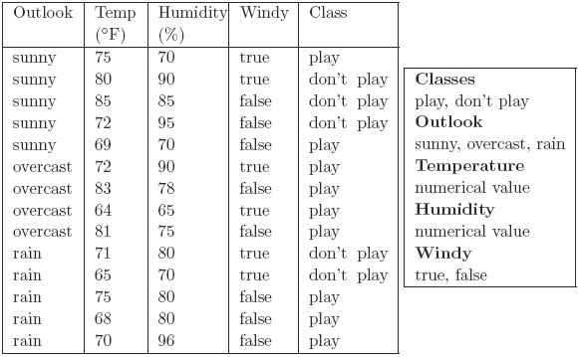
Notes:
How can we use this dataset to apply Naïve Bayes and KNN??

